Slide 1
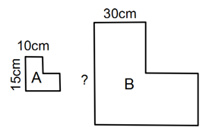
Starter – Daily 5
1. Find the highest common factor of 30 and 18
2. To work out a shorter side of a right-angled triangle when we know the hypotenuse and the other side we rewrite Pythagoras’ Theorem to get the unknown side by itself. It looks like ________ = ________ - __________.
3. Find the scale factor of the following shape (A is
the original)
4. Draw a scalene triangle
5. What does congruent mean?

Slide 2
Topic: Congruence and Similarity in Triangles
EQ: What is the difference between congruency and similarity and what tests can we use to determine if a triangle is one or the other?

Slide 3
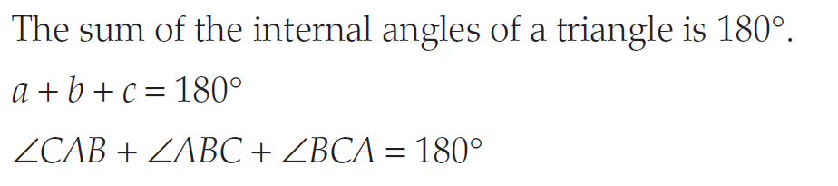
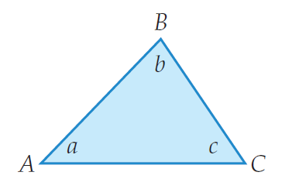
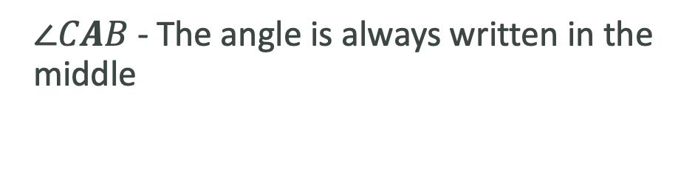
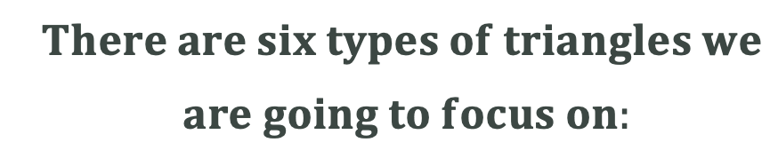
Topic: Congruence and Similarity in Triangles
EQ: What is the difference between congruency and similarity and what tests can we use to determine if a triangle is one or the other?
To recap:
$∠CAB$ - The angle is always written in the middle
$There are six types of triangles we$
$are going to focus on:$
Summary:

Slide 4
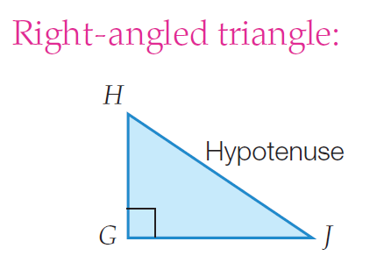
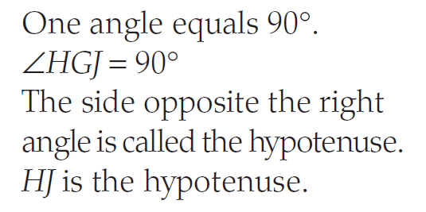
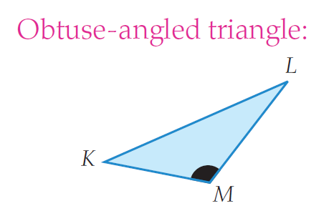
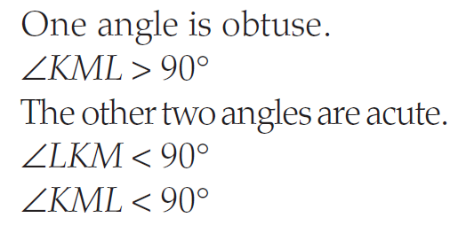
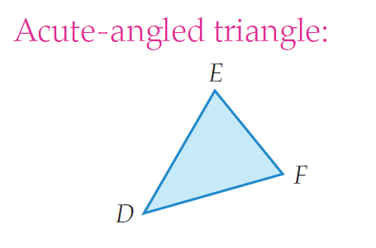
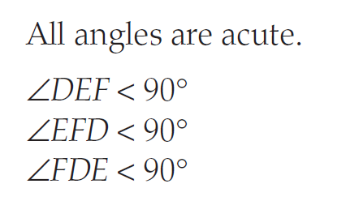
Topic: Congruence and Similarity in Triangles
EQ: What is the difference between congruency and similarity and what tests can we use to determine if a triangle is one or the other?
The following three triangles are named because of their angles:
2)
1)
3)

Slide 5
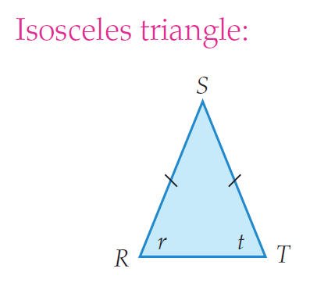
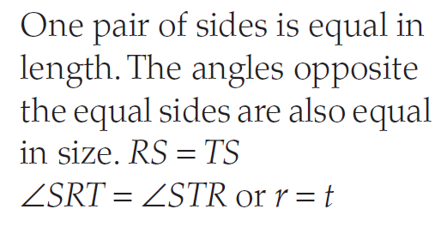
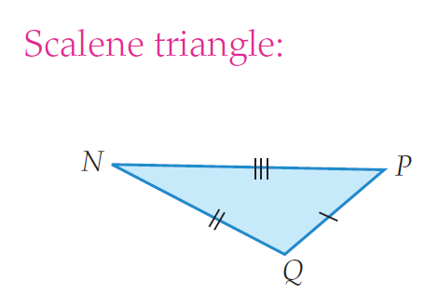
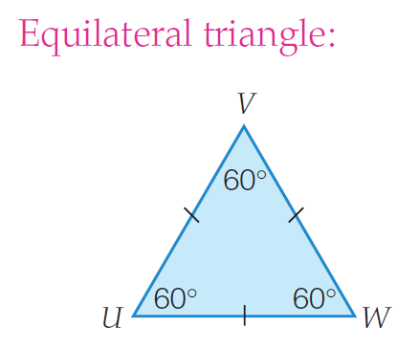
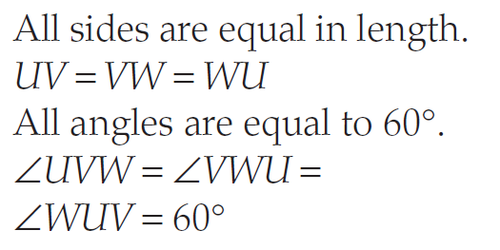
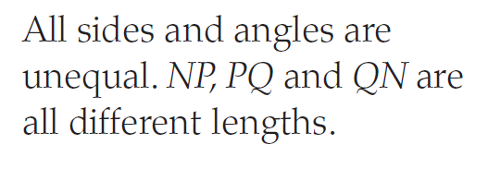
Topic: Congruence and Similarity in Triangles
EQ: What is the difference between congruency and similarity and what tests can we use to determine if a triangle is one or the other?
5)
The following three triangles are named because of their sides:
4)
6)

Slide 6
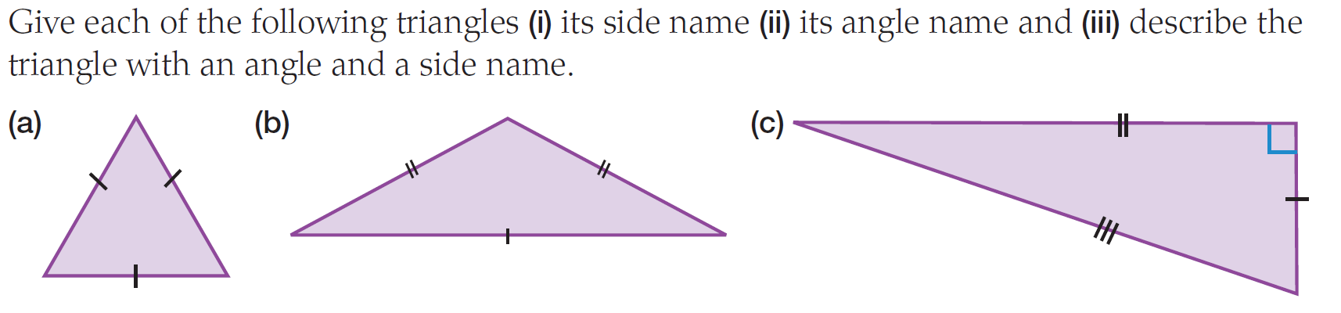
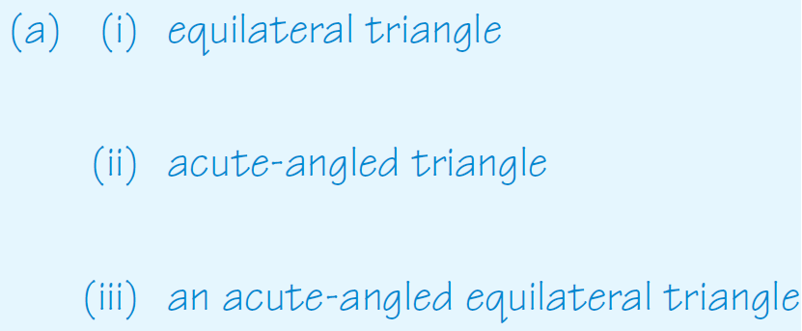
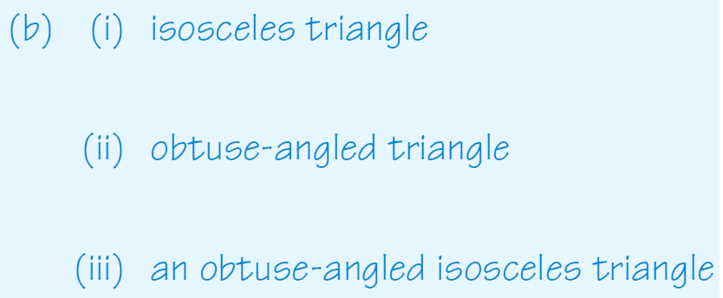
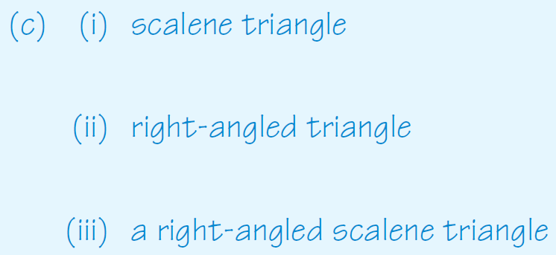
We do

Slide 7
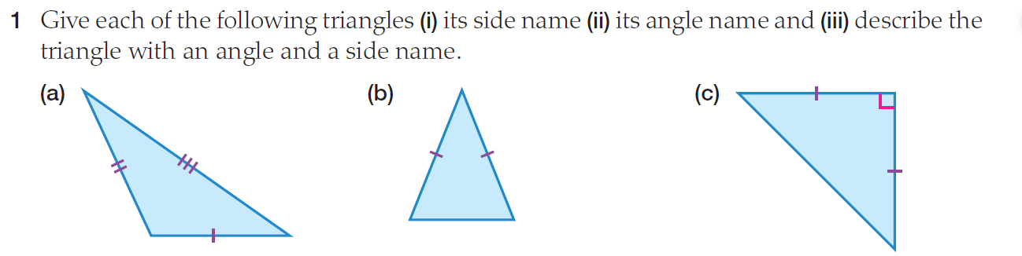
You do

Slide 8
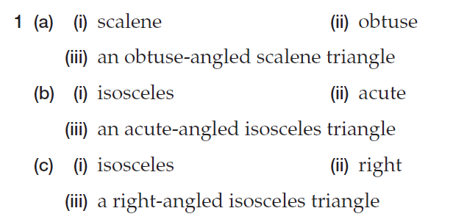
Answers

Slide 9
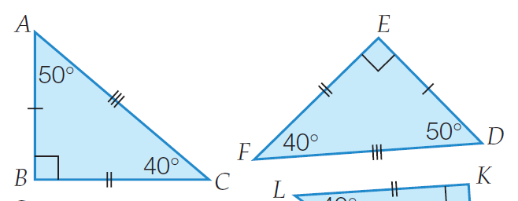
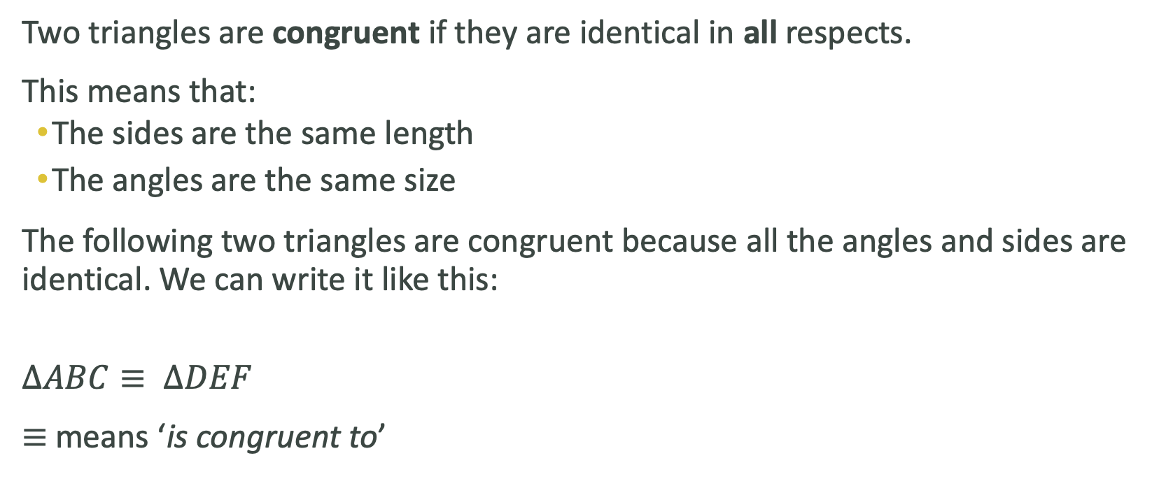
Topic: Congruence and Similarity in Triangles
EQ: What is the difference between congruency and similarity and what tests can we use to determine if a triangle is one or the other?
What is congruent?
Two triangles are congruent if they are identical in all respects.
This means that:
The sides are the same length
The angles are the same size
The following two triangles are congruent because all the angles and sides are identical. We can write it like this:
$$∆ABC≡ ∆DEF$$
$≡$ means ‘is congruent to’
There are four tests we use to prove triangles are congruent

Slide 10
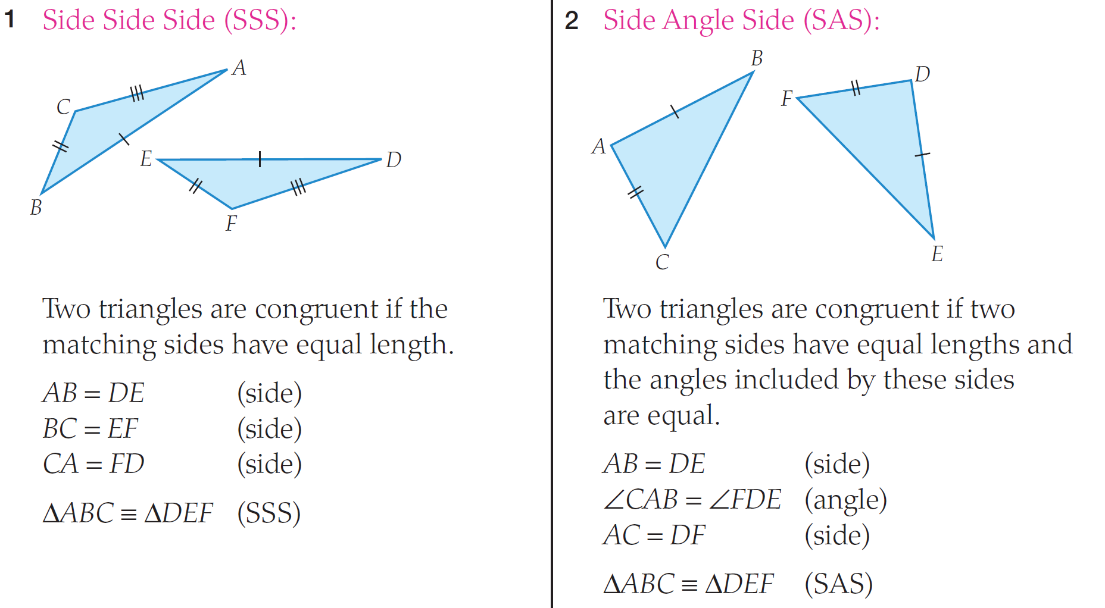
Tests for Congruent Triangles

Slide 11
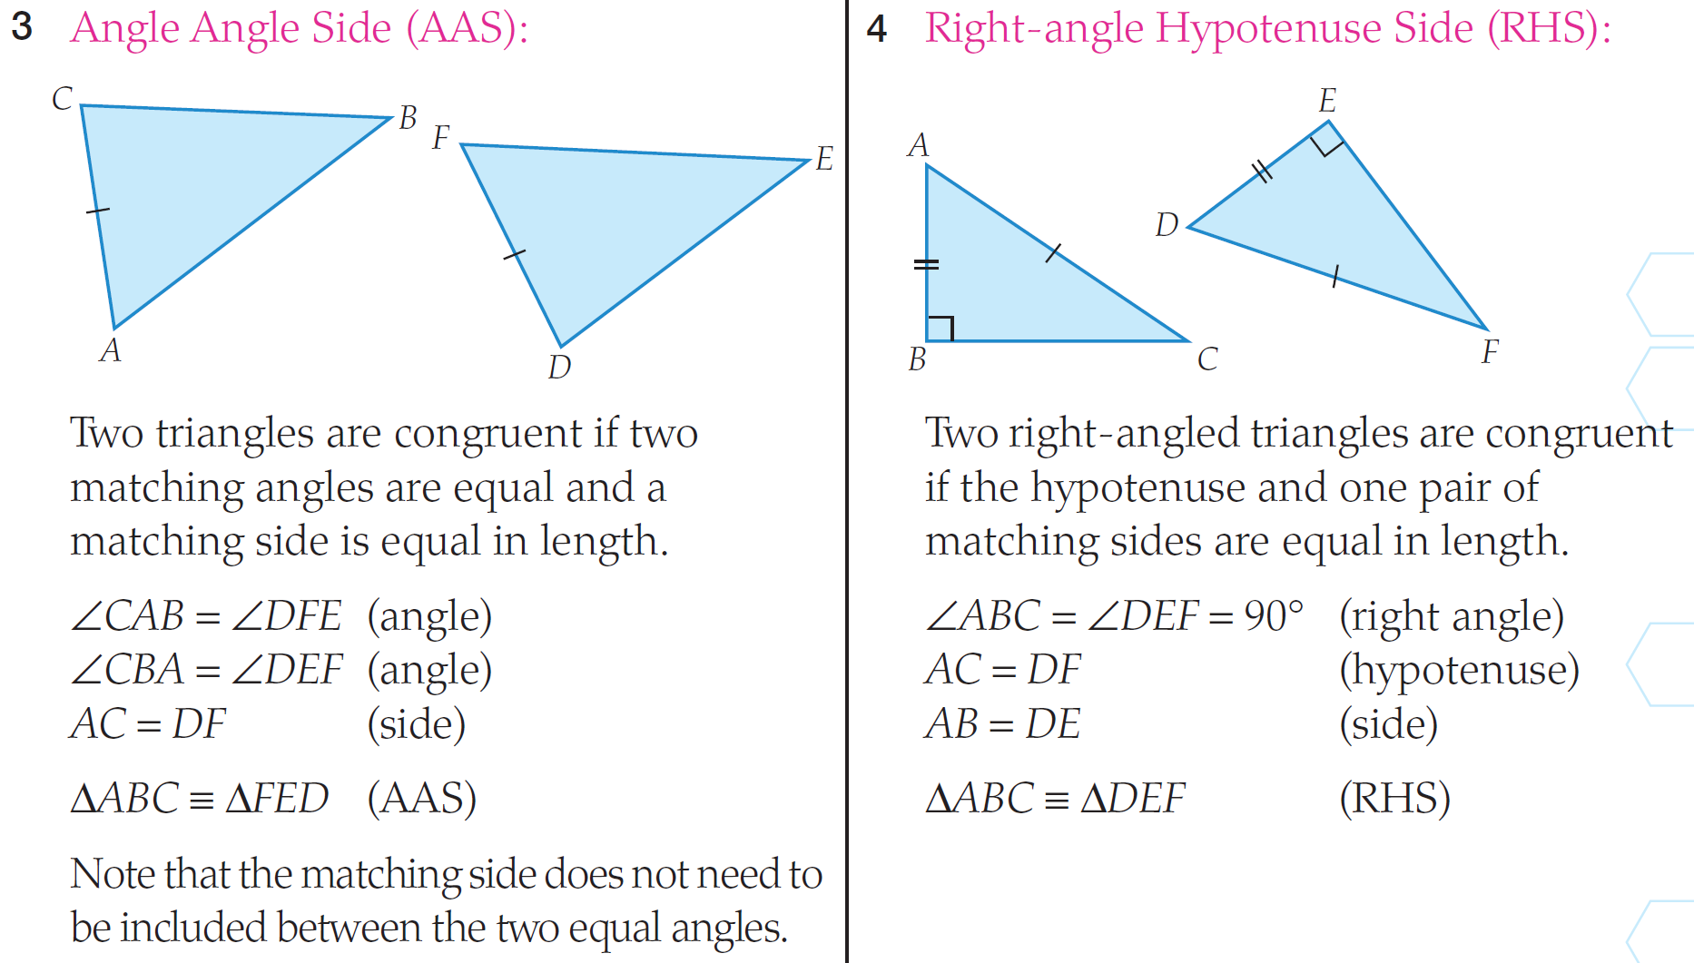
Tests for Congruent Triangles

Slide 12
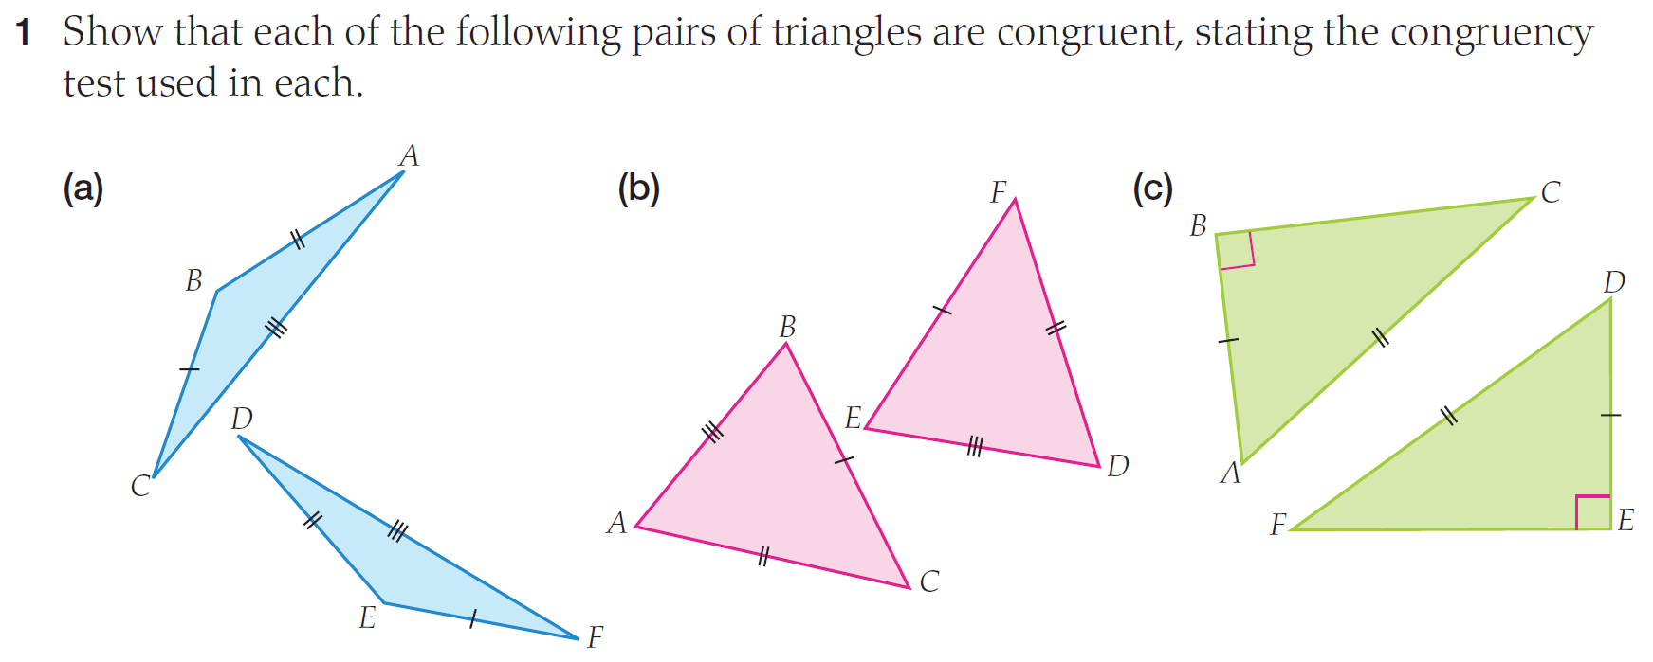

Slide 13
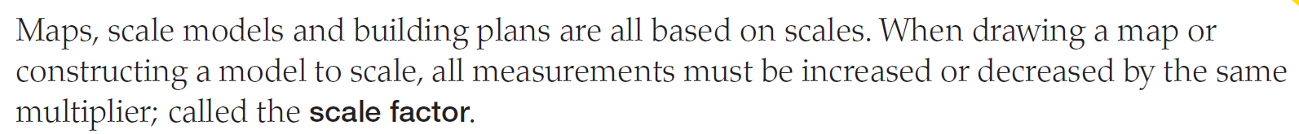
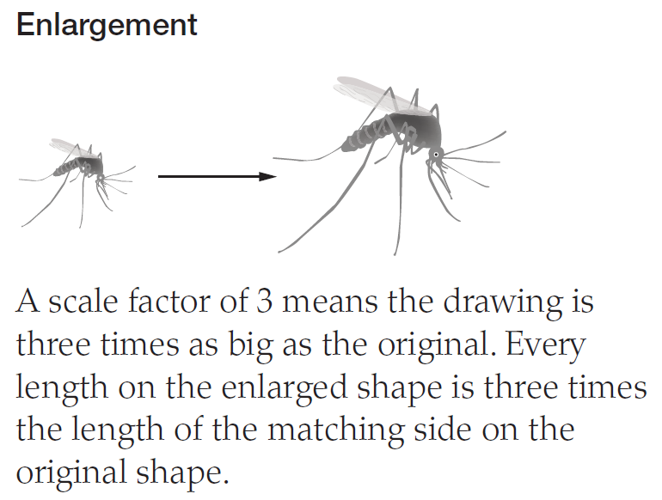
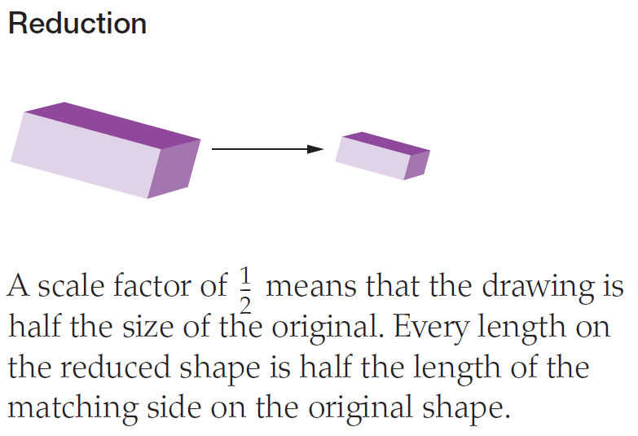
Topic: Congruence and Similarity in Triangles
EQ: What is the difference between congruency and similarity and what tests can we use to determine if a triangle is one or the other?
What does scale factor mean?

Slide 14
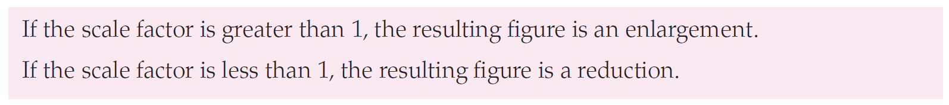
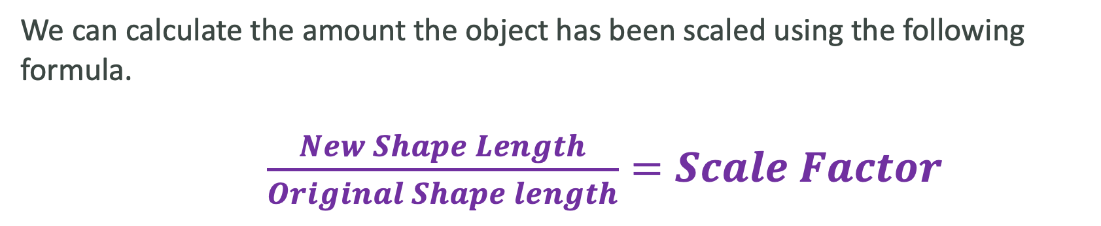
Topic: Congruence and Similarity in Triangles
EQ: What is the difference between congruency and similarity and what tests can we use to determine if a triangle is one or the other?
How do we calculate the scale factor?
We can calculate the amount the object has been scaled using the following formula.
$\frac{New Shape Length}{Original Shape length}=Scale Factor$

Slide 15
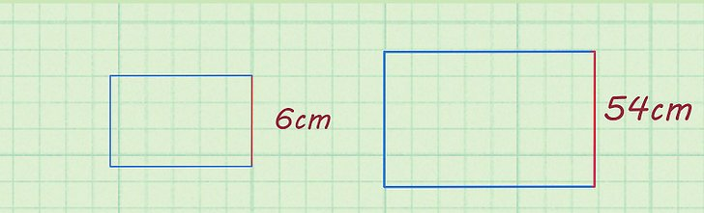

Example 1
Original Shape New shape
$\frac{New Shape Length}{Original Shape length}=Scale Factor$
In this case, the scale factor is greater than 1 so the shape has been enlarged.
Was the shape enlarged or reduced? Why?

Slide 16
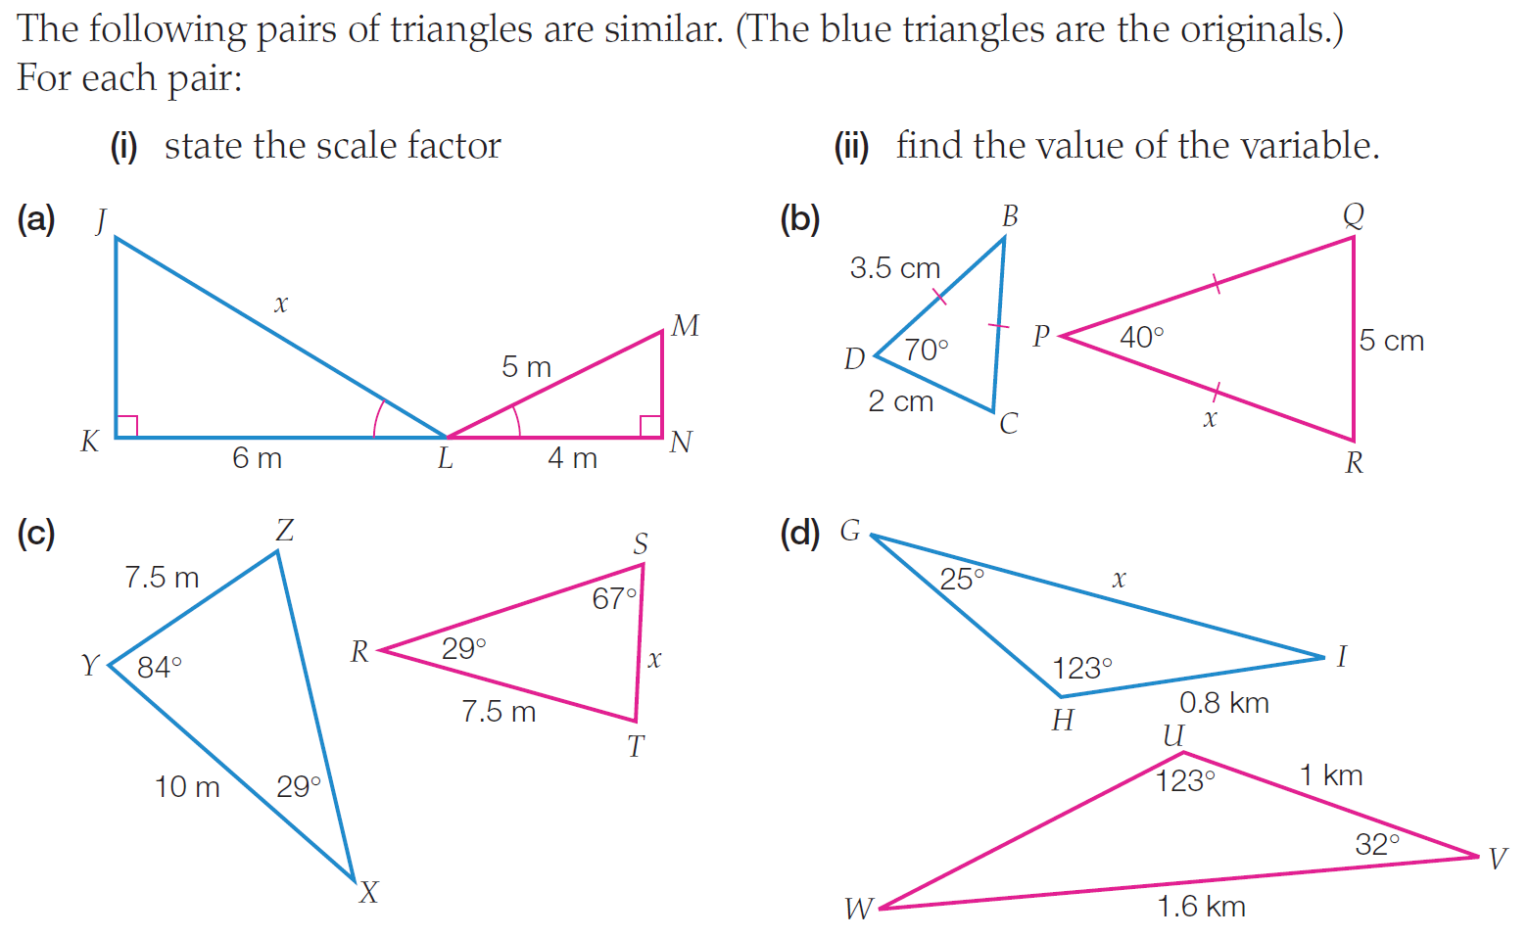
Task on the L.H.S

Slide 17
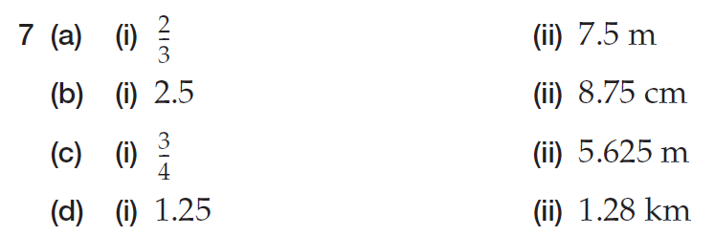
Answer

Slide 18
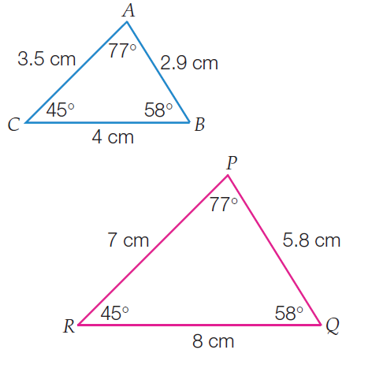
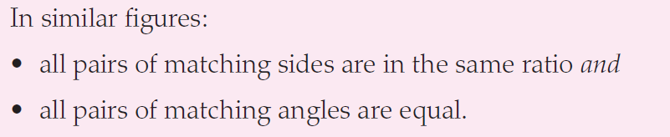
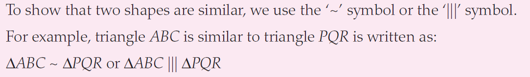
Topic: Congruence and Similarity in Triangles
EQ: What is the difference between congruency and similarity and what tests can we use to determine if a triangle is one or the other?
What does similar mean?
Similar figures have the same shape, but not necessarily the same size.
Similar Triangles: Same shape but different size
Congruent Triangles: Same shape and same size

Slide 19
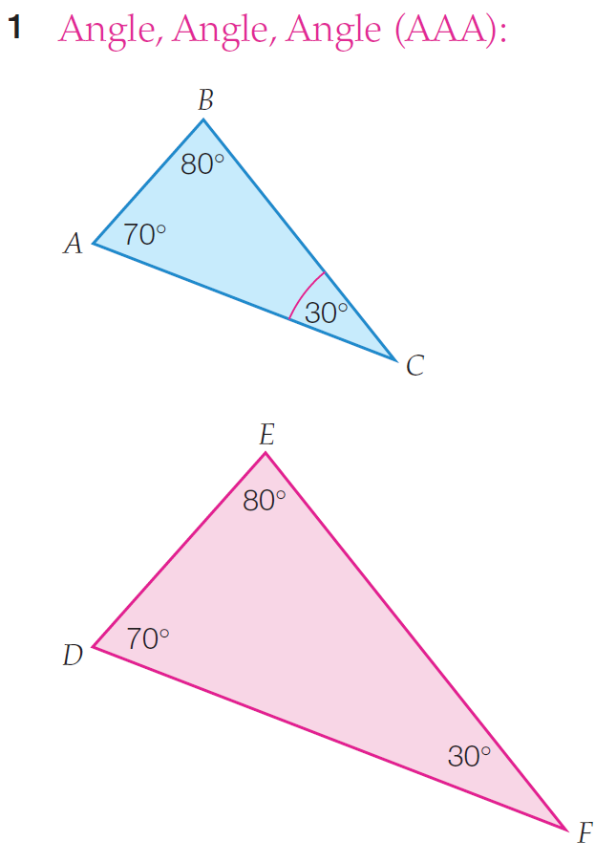
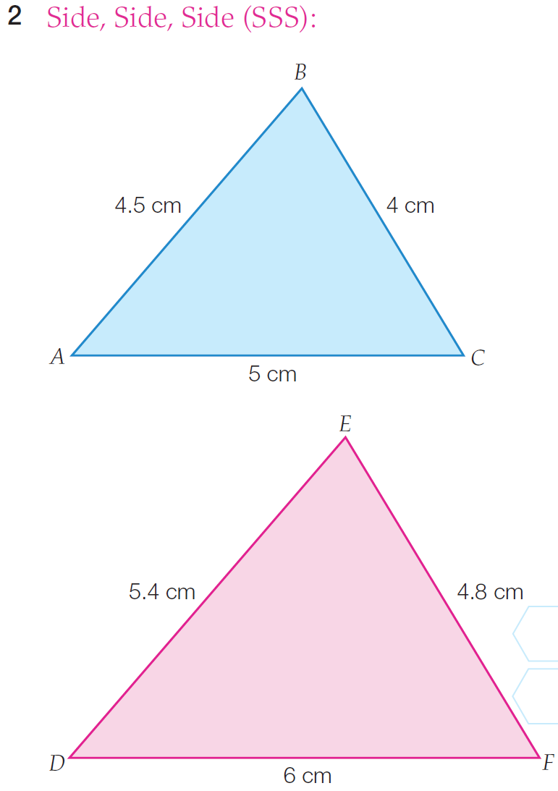
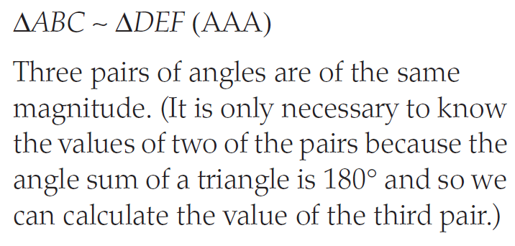
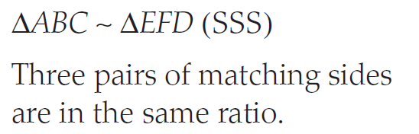
Topic: Congruence and Similarity in Triangles
EQ: What is the difference between congruency and similarity and what tests can we use to determine if a triangle is one or the other?
Just like congruency, we can use 4 types of tests to see if the triangles are similar

Slide 20
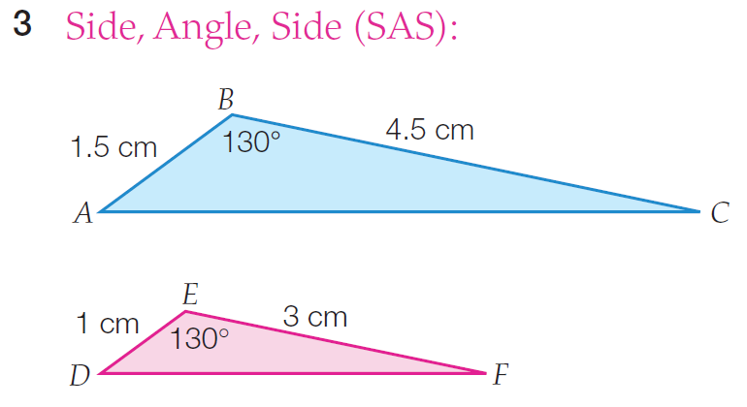
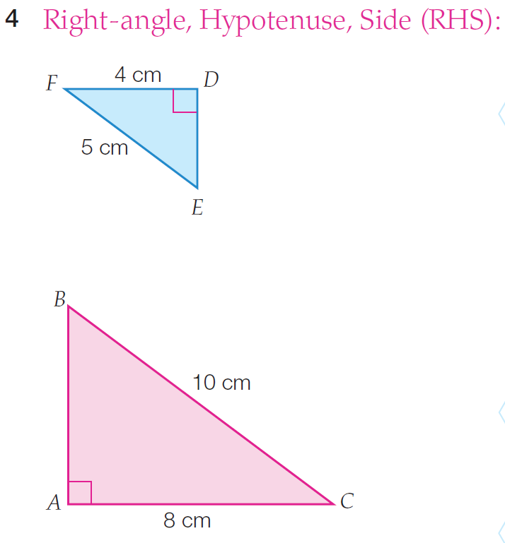
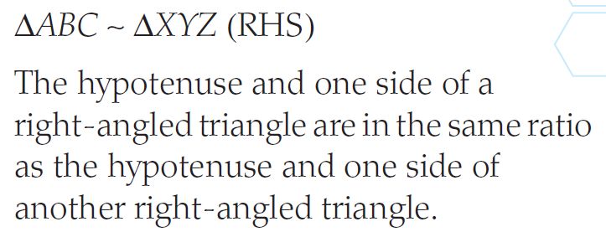
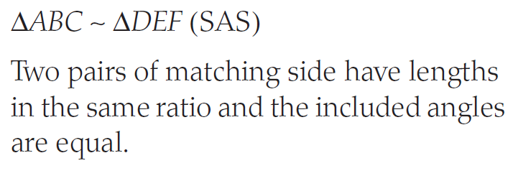
Topic: Congruence and Similarity in Triangles
EQ: What is the difference between congruency and similarity and what tests can we use to determine if a triangle is one or the other?

Slide 21
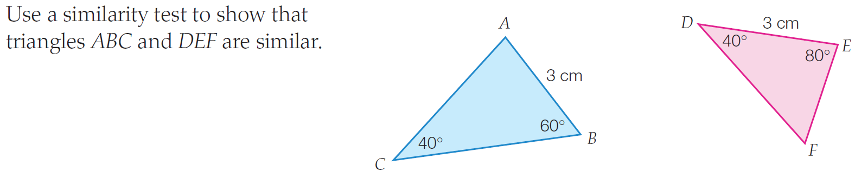
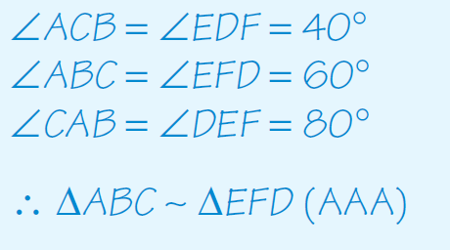
Example

Slide 22
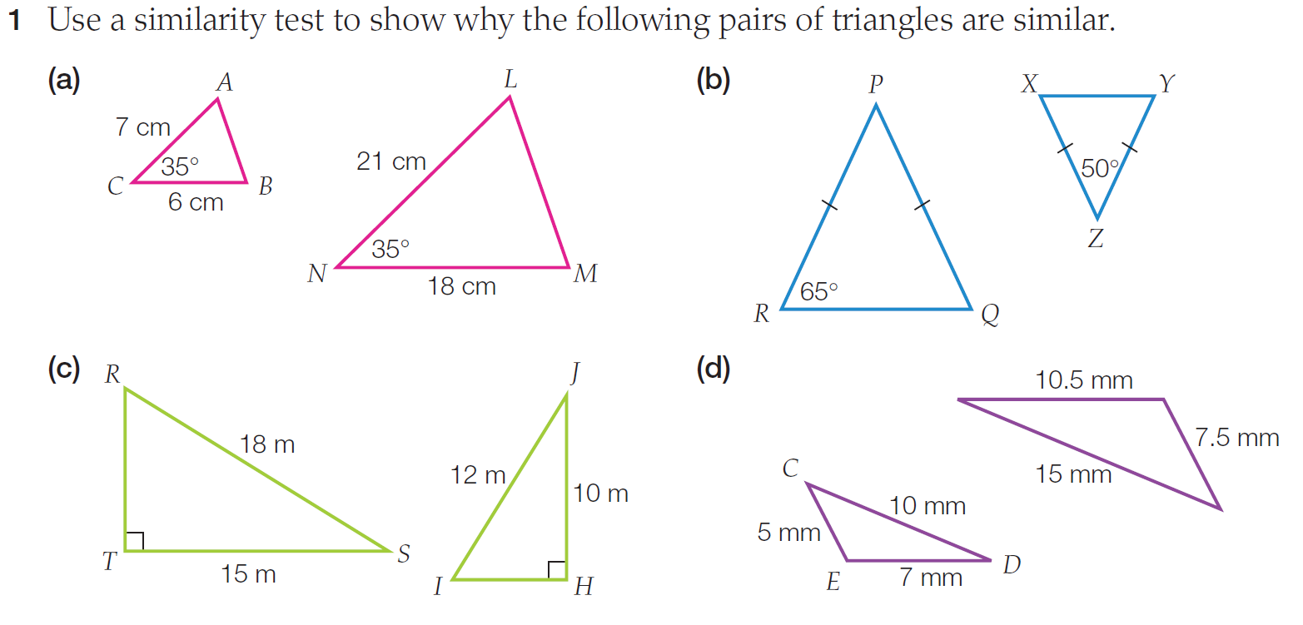

Slide 23



Slide 24

Practice
Similarity and Congruence Worksheets
Notes:
Independent practice

Slide 25
Exit ticket
Write a summary answering the essential question.
Add at least three new terms to your glossary

